Slide 1
Conducting a User Study
Human-Computer Interaction

Slide 2
Overview
What is a study?
  Empirically testing a hypothesis
  Evaluate interfaces
Why run a study?
  Determine ‘truth’
  Evaluate if a statement is true

Slide 3
Example Overview
Ex. The heavier a person weighs, the higher their blood pressure
  Many ways to do this:
    Look at data from a doctor’s office
    Descriptive design: What’s the pros and cons?
    Get a group of people to get weighed and measure their BP
    Analytic design: What’s the pros and cons?
    Ideally?
  Ideal solution: have everyone in the world get weighed and BP
    Participants are a sample of the population
    You should immediately question this!
    Restrict population

Slide 4
Study Components
Design
  Hypothesis
  Population
  Task
  Metrics
Procedure
Data Analysis
Conclusions
Confounds/Biases

Slide 5
Study Design
How are we going to evaluate the interface?
  Hypothesis
    What do you want to find out?
  Population
    Who?
  Metrics
    How will you measure?

Slide 6
Hypothesis
Statement that you want to evaluate
  Ex. A mouse is faster than a keyboard for numeric entry
Create a hypothesis
  Ex. Participants using a keyboard to enter a string of numbers will take less time than participants using a mouse.
Identify Independent and Dependent Variables
  Independent Variable – the variable that is being manipulated by the experimenter (interaction method)
  Dependent Variable – the variable that is caused by the independent variable. (time)

Slide 7
Hypothesis Testing
Hypothesis:
  People who use a mouse and keyboard will be faster to fill out a form than keyboard alone.
US Court system: Innocent until proven guilty
NULL Hypothesis: Assume people who use a mouse and keyboard will fill out a form than keyboard alone in the same amount of time
Your job to prove differently!
Alternate Hypothesis 1: People who use a mouse and keyboard will fill out a form than keyboard alone, either faster or slower.
Alternate Hypothesis 2: People who use a mouse and keyboard will fill out a form than keyboard alone, faster.

Slide 8
Population
The people going through your study
Type - Two general approaches
  Have lots of people from the general public
    Results are generalizable
    Logistically difficult
    People will always surprise you with their variance
  Select a niche population
    Results more constrained
    Lower variance
    Logistically easier
Number
  The more, the better
  How many is enough?
  Logistics
Recruiting (n>20 is pretty good)

Slide 9
Two Group Design
Design Study
  Groups of participants are called conditions
  How many participants?
  Do the groups need the same # of participants?
  What’s your design?
  What is the independent and dependent variables?

Slide 10
Design
External validity – do your results mean anything?
  Results should be similar to other similar studies
  Use accepted questionnaires, methods
Power – how much meaning do your results have?
  The more people the more you can say that the participants are a sample of the population
  Pilot your study
Generalization – how much do your results apply to the true state of things

Slide 11
Design
People who use a mouse and keyboard will be faster to fill out a form than keyboard alone.
Let’s create a study design
  Hypothesis
  Population
  Procedure
Two types:
  Between Subjects
  Across Subjects

Slide 12
Procedure
Formally have all participants sign up for a time slot (if individual testing is needed)
Informed Consent (let’s look at one)
Execute study
Questionnaires/Debriefing (let’s look at one)

Slide 13
Biases
Hypothesis Guessing
  Participants guess what you are trying hypothesis
Experimenter Bias
  Subconscious bias of data and evaluation to find what you want to find
Systematic Bias
  bias resulting from a flaw integral to the system
    E.g. an incorrectly calibrated thermostat)
List of biases
  http://en.wikipedia.org/wiki/List_of_cognitive_biases

Slide 14
Confounds
Confounding factors – factors that affect outcomes, but are not related to the study
Population confounds
  Who you get?
  How you get them?
  How you reimburse them?
  How do you know groups are equivalent?
Design confounds
  Unequal treatment of conditions
  Learning
  Time spent

Slide 15
Metrics
What you are measuring
Types of metrics
  Objective
    Time to complete task
    Errors
    Ordinal/Continuous
  Subjective
    Satisfaction
Pros/Cons of each type?

Slide 16
Analysis
Most of what we do involves:
  Normal Distributed Results
  Independent Testing
  Homogenous Population

Slide 17
Raw Data
Keyboard times
  E.g. 3.4, 4.4, 5.2, 4.8, 10.1, 1.1, 2.2
  Mean = 4.46
  Variance = 7.14 (Excel’s VARP)
  Standard deviation = 2.67 (sqrt variance)
What do the different statistical data tell us?

Slide 18
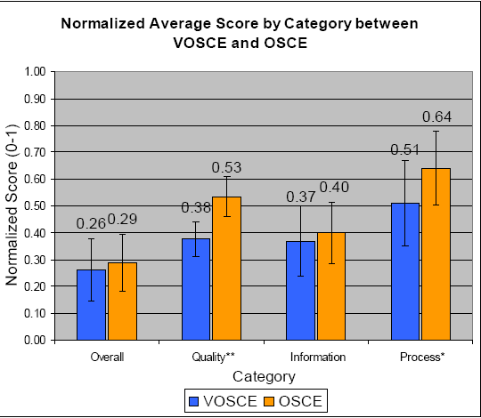
What does Raw Data Mean?

Slide 19
Roll of Chance
How do we know how much is the ‘truth’ and how much is ‘chance’?
How much confidence do we have in our answer?

Slide 20
Hypothesis
We assumed the means are “equal”
But are they?
Or is the difference due to chance?
  Ex. A μ₀ = 4, μ₁ = 4.1
  Ex. B μ₀ = 4, μ₁ = 6

Slide 21
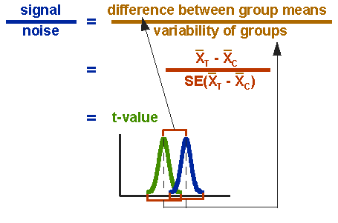
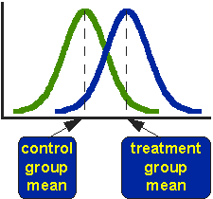
T - test
T – test – statistical test used to determine whether two observed means are statistically different

Slide 22
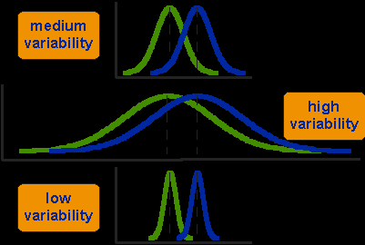
T-test
Distributions

Slide 23

T – test
(rule of thumb) Good values of t > 1.96
Look at what contributes to t
http://socialresearchmethods.net/kb/stat_t.htm

Slide 24
F statistic, p values
F statistic – assesses the extent to which the means of the experimental conditions differ more than would be expected by chance
t is related to F statistic
Look up a table, get the p value. Compare to α
α value – probability of making a Type I error (rejecting null hypothesis when really true)
p value – statistical likelihood of an observed pattern of data, calculated on the basis of the sampling distribution of the statistic. (% chance it was due to chance)

Slide 25
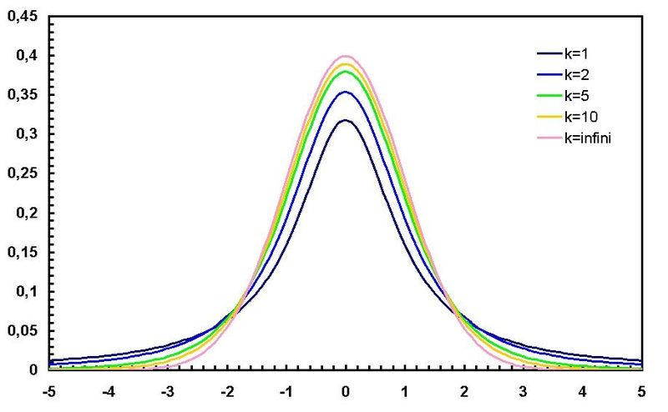
T and alpha values

Slide 26
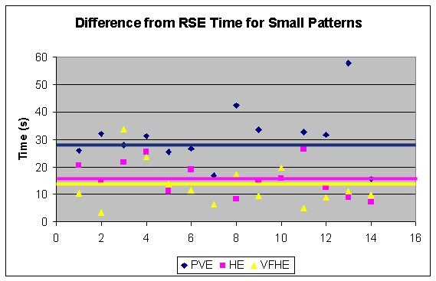
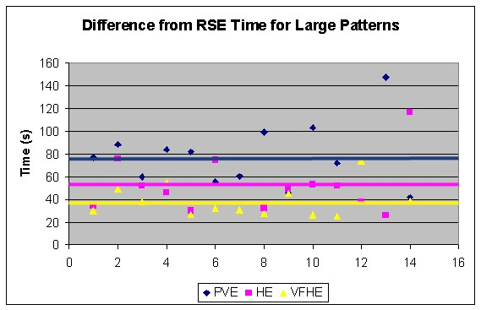
Small Pattern
Large Pattern
t – test
with unequal variance
p – value
t – test
with unequal variance
p - value
PVE – RSE vs.
VFHE – RSE
3.32
0.0026**
4.39
0.00016***
PVE – RSE vs.
HE – RSE
2.81
0.0094**
2.45
0.021*
VFHE – RSE vs.
HE – RSE
1.02
0.32
2.01
0.055⁺

Slide 27
Significance
What does it mean to be significant?
You have some confidence it was not due to chance.
But difference between statistical significance and meaningful significance
Always know:
  samples (n)
  p value
  variance/standard deviation
  means

Slide 28
IRB
http://irb.ufl.edu/irb02/index.html
Let’s look at a completed one
You MUST turn one in before you complete a study
Must have OKed before running study

